Slide 1

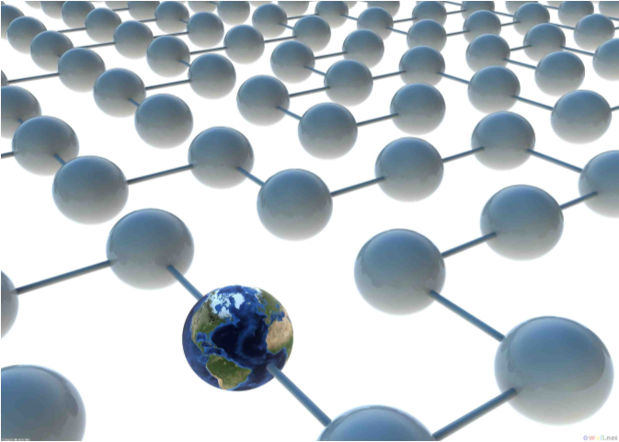
Global Survival System

Slide 2
Survival
  Can we assume that we live in a hospitable, caring universe?
  What if we exist in a hostile competition with nature for survival? Are we, as a technologically developing planet, prepared for cosmic catastrophe?
  We suggest a software tool that can assist all people - even including survivors of cataclysmic events.

Slide 3
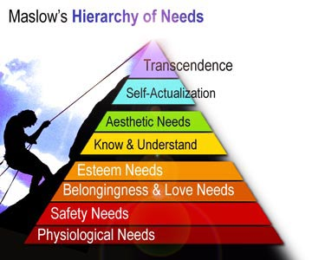
”Appropriate” for an Organism
Appropriateness of a given environment, at a specific time, for a specific organism (human, animal, or plant, etc...), may be calculated in terms of its needs.

Slide 4
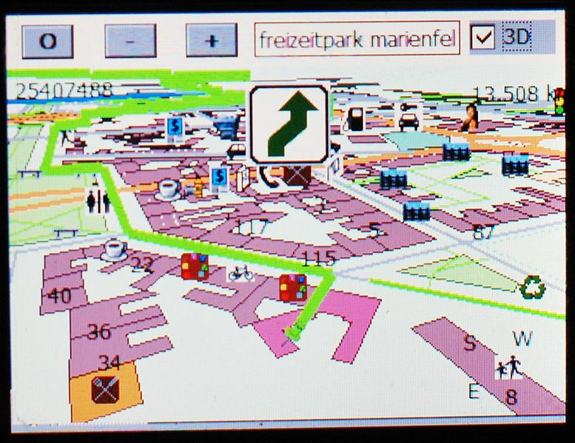
Where is it most "Appropriate" to be, now?
We can analyze all physical locations, and the transitions between them, to find those which seem appropriate for a biological organism - measured according to certain heuristics.

Slide 5
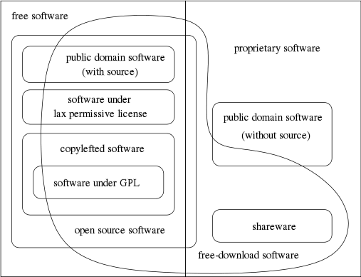
Free and Open-Source
  The tool must be easy and free for all people (and possibly animals) to use, modify or improve it.
  We must not allow life to depend on errors that programmers outside of a closed-source team can't find and fix.
  We must not allow life to depend on a profit-driven decision made at the expense of the life-supporting system's usefulness, correctness, or accessibility.
  "Open API" is not enough - in this case, it needs to be completely open source.

Slide 6
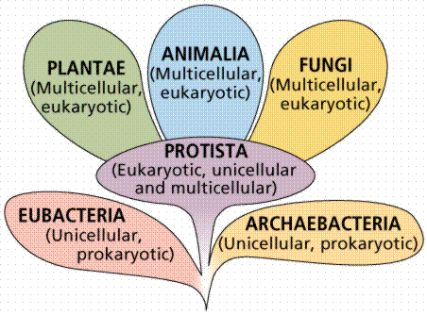
A Distributed Government that Guarantees Ecstatic Survival
This tool is equivalent to a universal constitution that can logically grant all beings equal rights to existence.

Slide 7
An Organism's Needs
  Analyzes all aspects of a group of organisms’ existence within an ecosystem of demands and available resources...
  ...including all biological and psychological needs which could possibly affect the length and quality of life of a living being...
  ...including humans, animals, plants
  ...or abstract entities such as ecosystems, families, organizations, and corporations.

Slide 8
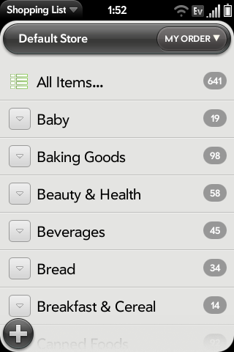
A Community's Needs
  Each being’s needs can be specified, and adjusted as necessary...
  ...forming an up-to-date manifest of a community’s essential requirements.
  Includes both abstract conditions and physical items.

Slide 9
Global Real-time Sensor Network
  Integrates all available sensor data via the Internet - increasing the planet's awareness of itself
  Interprets and distills all data, classifying any spatiotemporal location into either a relative...
benefit or threat
  …with regard to a particular organism's survival concerns.

Slide 10
Thrive or Suffer
  Software can estimate whether a complete manifest of needs can be satisfied by the ”available” resources -- illustrating how a community is likely to thrive or suffer.
  When shortages occur, the system can suggest alternate means of satisfying a more essential need. For example: by substituting an alternate source of a nutrient.
  If needs are not likely to be met, the system can attempt to provide a means of evacuation, or in the worst case: euthanasia.

Slide 11
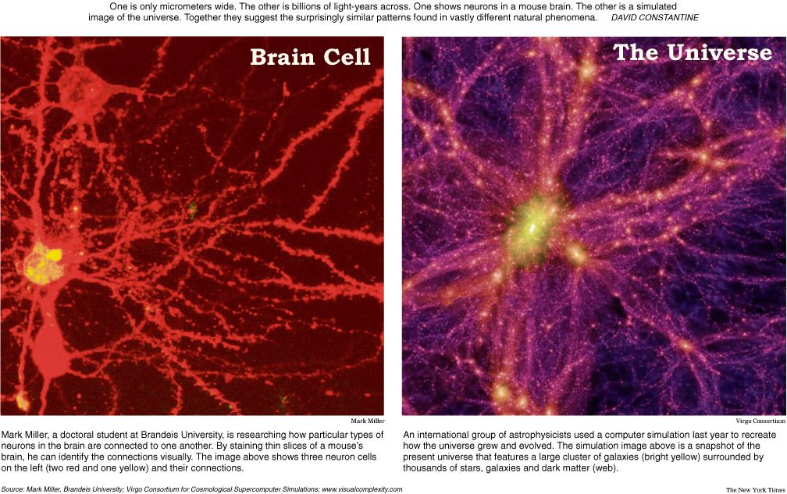
Simultaneously Global & Local
...and everything in-between
  From planetary-scale events...
    earthquakes, space weather, radiation, etc...
  ...to neighborhood-scale features
    the availability of a bed, a fruit tree, etc...
The same algorithms apply equally to planning intercontinental migration, as well as navigating neighborhood errands

Slide 12
Subjectivity and Presets
  You are responsible for selecting the relative importance of each data indicator when creating a map or route
  The tool provides selectable ”presets” which are updated and improved by experts according to professionally and scientifically determined regulations.
  Unifies the functionality of several United States agencies:
    FDA, EPA, CDC, ...and others

Slide 13

"What May I Need?"
Maps Conditions to Products...
  Provides relevant product & service suggestions for any situation according to a semantic rule system
  Voting & comments democratically crowdsource increasingly better suggestions, from within the software
  Any e-store or affiliate is free to advertise and sell by contributing rules that generate suggestions for various situations

Slide 14
Survival Store
Advertising According to Relevant Necessity
  ”What May I Need?” answerable at any given time
  Associates resources with the organism needs that they satisfy....
  ...both in the presence of certain conditions, and the lack of other conditions
  Integrates with e-stores and distributors
  Recommends and advertises products and educates about how to use them
Immense Opportunity for E-Commerce: Advertising and Sale Revenue

Slide 15

Taken to its Logical Conclusion...
Rational Eudaemonic Systematic Universal Savior
  A completely transparent, internet-powered, distributed, planetary mind that manages Earth's resources towards the survival of all beings and the manifestation of all humanity's dreams for the future.
  It explains all of its decisions and conclusions in terms of factual data collected from sensors and human input.
eu·dae·mon·ic /ˌyo͞odəˈmänik/
Adjective: Conducive to happiness.

Slide 16
DATA SOURCES

Slide 17
Shelter
  Homes
  Apartments
  Shelters
    Bridges
  Hospitals
  Beds
  Campgrounds, Tents and Temporary Housing

Slide 18
Water & Food

Slide 19
Safety
  Crime
  Fire Protection
  Disaster Relief

Slide 20
Pollution
  Industrial Pollution
  Radiation
  Chemtrails
  Electrosmog (ex: Cell phone towers)

Slide 21
Energy
  Sustainable energy
  Pre-paid energy
  Conventional & Smart power grids

Slide 22
Communication
  Mail
  Phone
  Internet
  Radio

Slide 23
Healthcare
  Doctors
  Hospitals
  Pharmacies
  Therapy
  Life Expectancy
  Disease, Epidemics, and Pandemics

Slide 24
Education
  Childcare
  Public and Private Schools
  Universities
  Classes & Opportunities to Learn

Slide 25
Transportation

Slide 26
Population Demographics

Slide 27
Waste Disposal & Recycling

Slide 28
Economy
  Banks and Credit Unions
  Taxes, Permits, and Fines
  ATM's
  Cost of Living

Slide 29
Agriculture

Slide 30
Natural Disasters
  Earthquake
  Volcano
  Fire
  Flood
  Tsunami
  Storm, Tornado, Hurricane

Slide 31
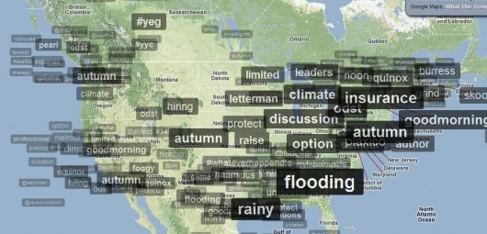
Semantic Trends
"The words on the map are taken from recent Twitter tweets... tracking the words, or topics, as they become more or less popular in overall tweets..."
http://TrendsMap.com
  Many ways of usefully interpreting this data...
  ...but let's use open [micro-]blogging and social platforms, instead of Twitter.com (which is proprietary and closed-source)

Slide 32
PROTOTYPES

Slide 33
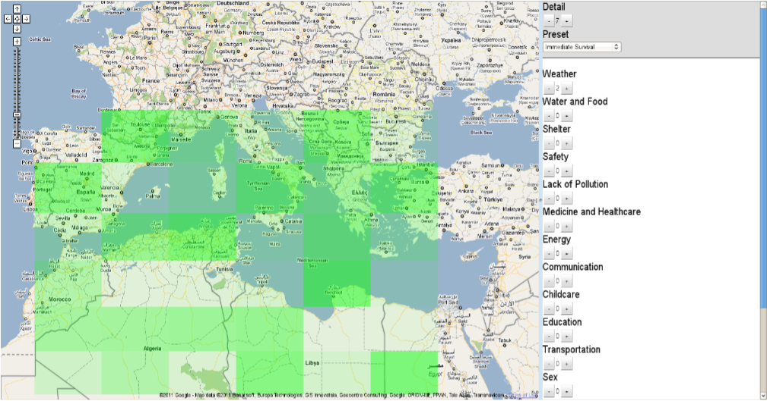
Prototype 1
Java/GWT - Late 2010

Slide 34
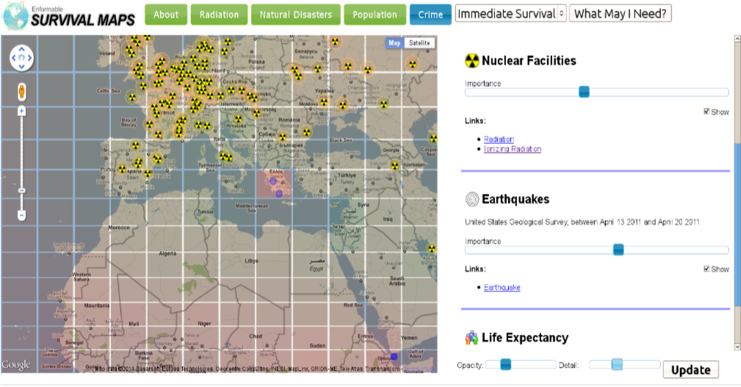
Prototype 2
HTML/Javascript - Mid 2011

Slide 35
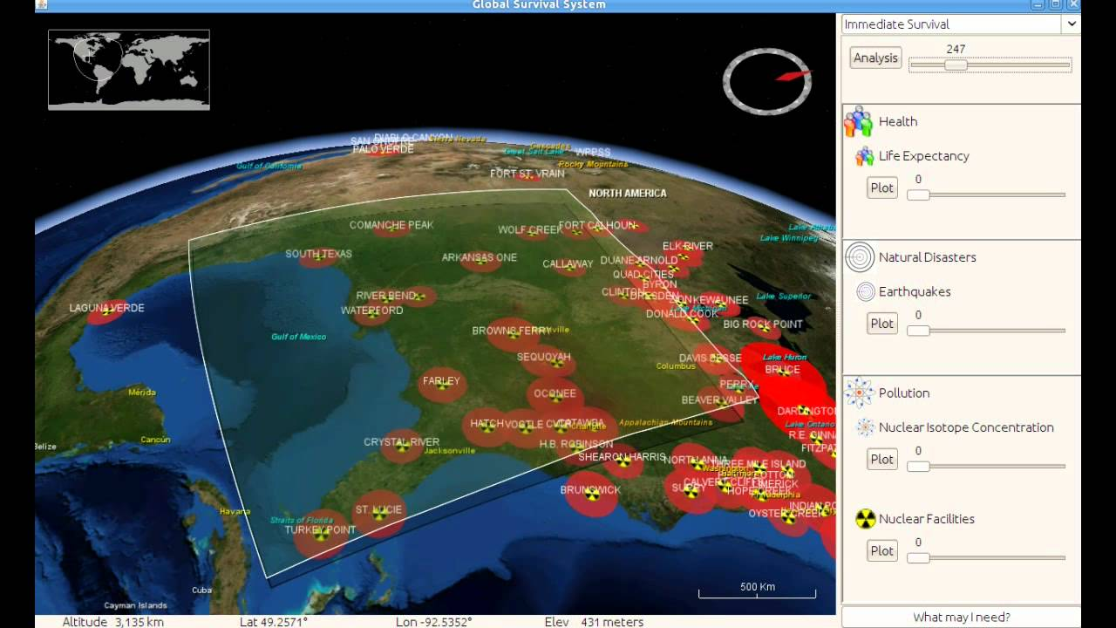


Prototype 3
Java / NASA WorldWind - Mid 2011

Slide 36
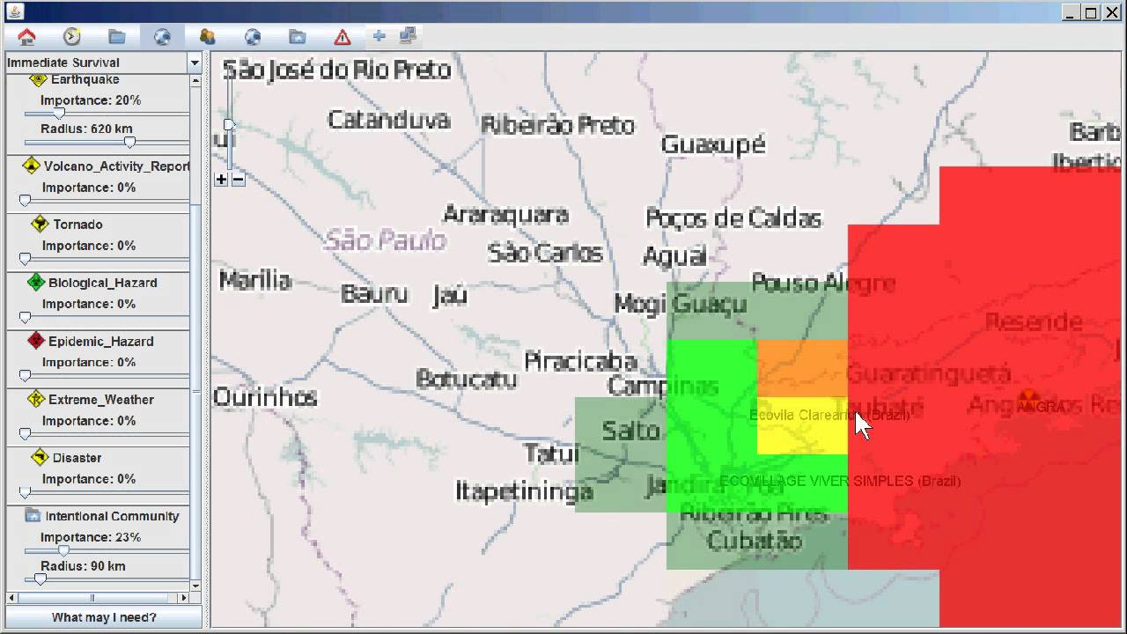


Prototype 4
Java/Swing - Early 2012

Slide 37
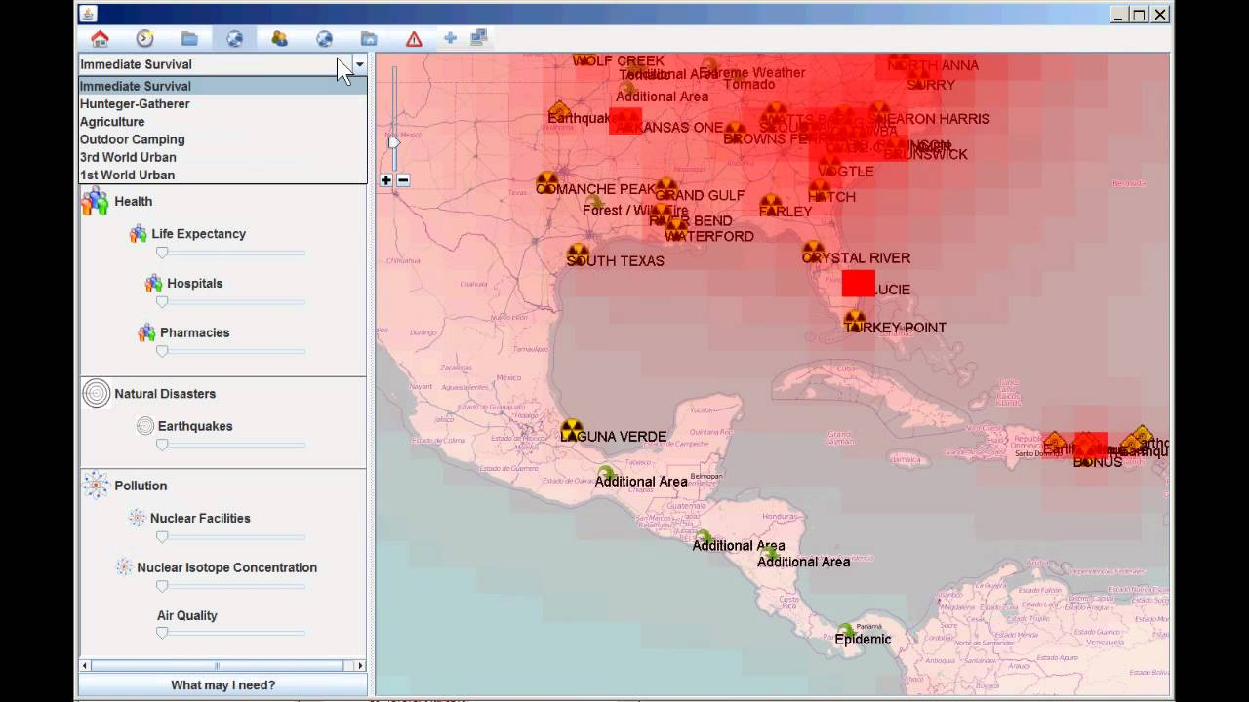


Prototype 4
(continued)
Java/Swing - Early 2012

Slide 38
APPENDIX

Slide 39
Open Manufacturing
  Open designs for building...
    Equipment
    Machines
    Software
    Relationships
    Educations
    Food
    etc...
  Applies to the factory as well as the kitchen
  Sustainable Supply Chain

Slide 40
Accountability & Reputation
  The history of success in satisfying the survival needs of organisms forms a quantifiable reputation of its community’s ability to support its members.
  Can we exceed the compassion of modern governments which avoid measuring the success of its population in a direct, biological way?
  Adaptive strategies applied in decentralized networks eliminate any centralizing bureaucracy or single-point-of-failure.

Slide 41

Survival vs. Luxury
  By demonstrating how all individuals have the potential to survive, the system separates economies into two markets:
    Survival Market - involving products which may be essential to survival
    Luxury Market - involving products which are entirely non-essential to survival

Slide 42
Everyone Survives, Even if the Community Doesn't Thrive
  Only when the Survival Market remains balanced should participants be concerned with growth in Luxury Markets.
  This prevents wealthy individuals from recklessly gambling with the same currency which could sustain life
  ...an unfortunate condition which currently plagues Earth’s global economy and oppresses a significant part of the planet’s population.

Slide 43
Freedom and Happiness
  Open-source
  Available for everyone
  Helps animals too
  We can all contribute to improve this system
  No excuse for not implementing it ASAP! We needed it yesterday!

